Slide 1
Predicting magma fertility in porphyry copper deposits using machine learning
Jiajia Sun
02/07/2024

Slide 2
Outline
Copper
Magma fertility
Data

Slide 3
Outline
Copper
Magma fertility
Data

Slide 4
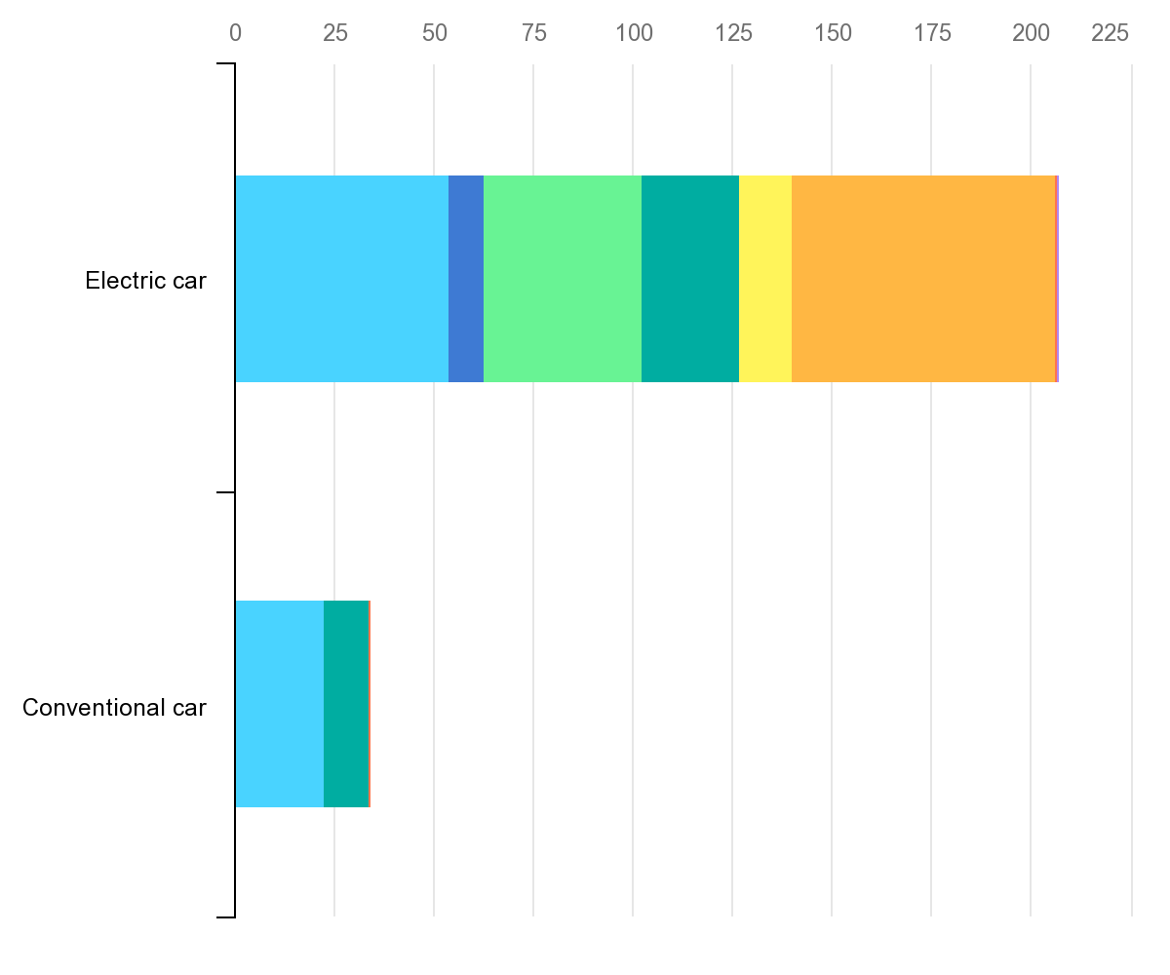
A typical EV requires six times the mineral inputs of a conventional car.
https://www.iea.org/reports/the-role-of-critical-minerals-in-clean-energy-transitions/executive-summary

Slide 5
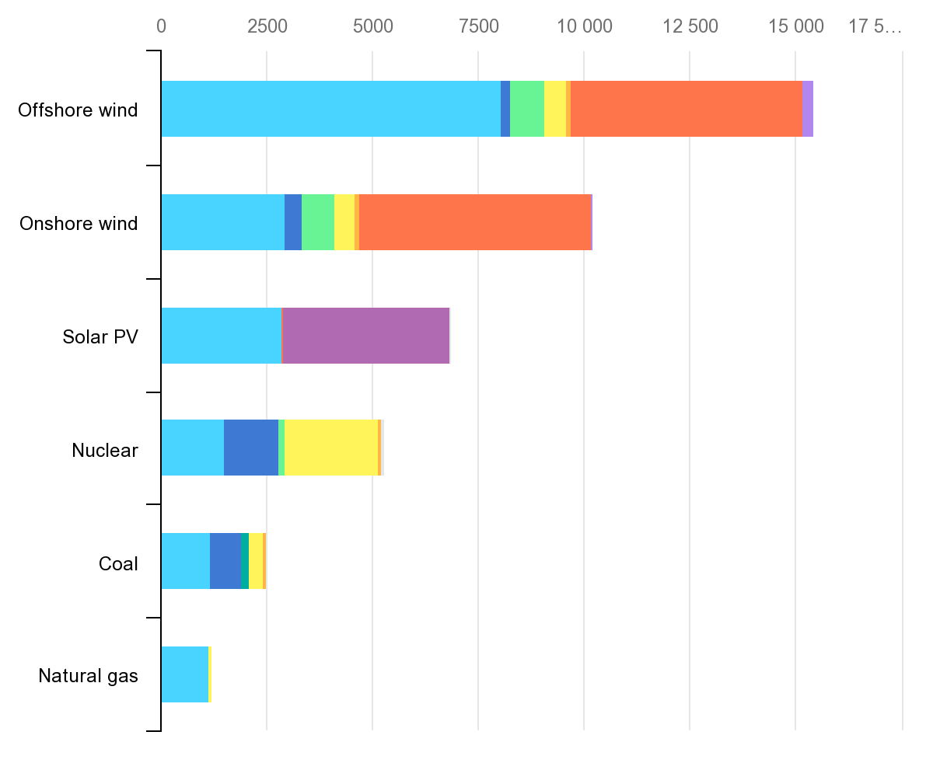
Onshore wind plant requires nine times more mineral resources than a gas-fired plant.
Minerals used in clean energy technologies compared to other power generation sources
https://www.iea.org/reports/the-role-of-critical-minerals-in-clean-energy-transitions/executive-summary

Slide 6
Basic ideas
We need a gigantic amount of copper and other metals in the next few decades
Porphyry copper deposits are a major source of copper
Therefore, finding new copper deposits is important.
Standard methods are not cost effective and require significant amount of prior knowledge about an area of exploration
The formation of porphyry copper deposits is associated with magma
Geochemical data contain information about whether magma are fertile (meaning that when magma cools down, copper will form) or not

Slide 7
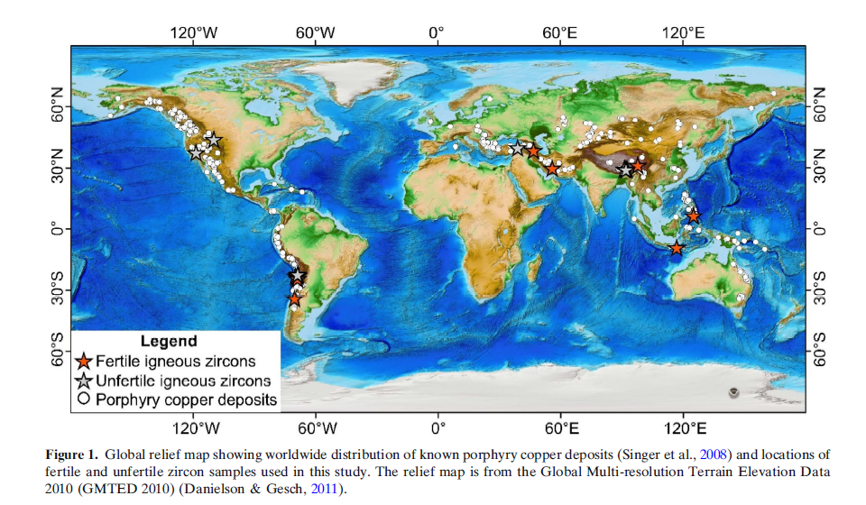

Slide 8
Outline
Copper
Magma fertility
Data

Slide 9
Mineral deposit types
Mineral deposits can be classified on the basis of the mechanism responsible for concentrating the valuable substance.

Slide 10
Mineralizing processes
Hydrothermal
Magmatic
Sedimentary
Placer
Residual

Slide 11
Concentration processes
Three basic requirements
Source (metals, minerals)
Crustal rocks, magma, mantle rocks
Transportation mechanism (fluids)
Hot water (hydrothermal), magma, surface water, ground water
Trap (depositional site)
Temperature/pressure change, or chemical reaction
Credit: Joanna Hodge https://www.youtube.com/watch?v=wInPtYnszR8
Notes:
There needs to be a source of metals and minerals, some mechanisms by which those metals and minerals are transported, and some means by which the minerals are trapped and concentrated.
These components differ depending on the type of mineralizing process that is taking place. For example, the source of metals and minerals may be crustal rocks, cooling magma or the mantle. Minerals and metals can be transported by hot water circulating through the crust, by magma moving through the crust or by groundwater as an example. Deposition commonly takes place as the result of a physical or chemical change to the fluid. A change in temperature or pressure can affect the solubility of elements dissolved in hot water, for example, or a chemical reaction may facilitate precipitation. In the case of placer deposits, changing velocity of groundwater will cause gold grains or diamonds to fall out of suspension.

Slide 12
Hydrothermal mineralization

Slide 13
Hydrothermal fluids
Hydrothermal: means hot water
Minerals in the hot fluids precipitate to form deposits (these deposits are called hydrothermal deposits).
Hydrothermal fluids dissolve and carry metals such as gold, silver, copper, lead and zinc, and circulate through the Earth’s crust.
Travel via temperature or pressure gradients (from high to low) or along crustal structures until they reach a suitable deposition site.
Credit: Joanna Hodge https://www.youtube.com/watch?v=wInPtYnszR8
Notes:
Hydrothermal fluids dissolve and carry metals such as gold, silver, copper, lead and zinc, that have been derived from other crustal rocks, and circulate through the Earth’s crust.

Slide 14
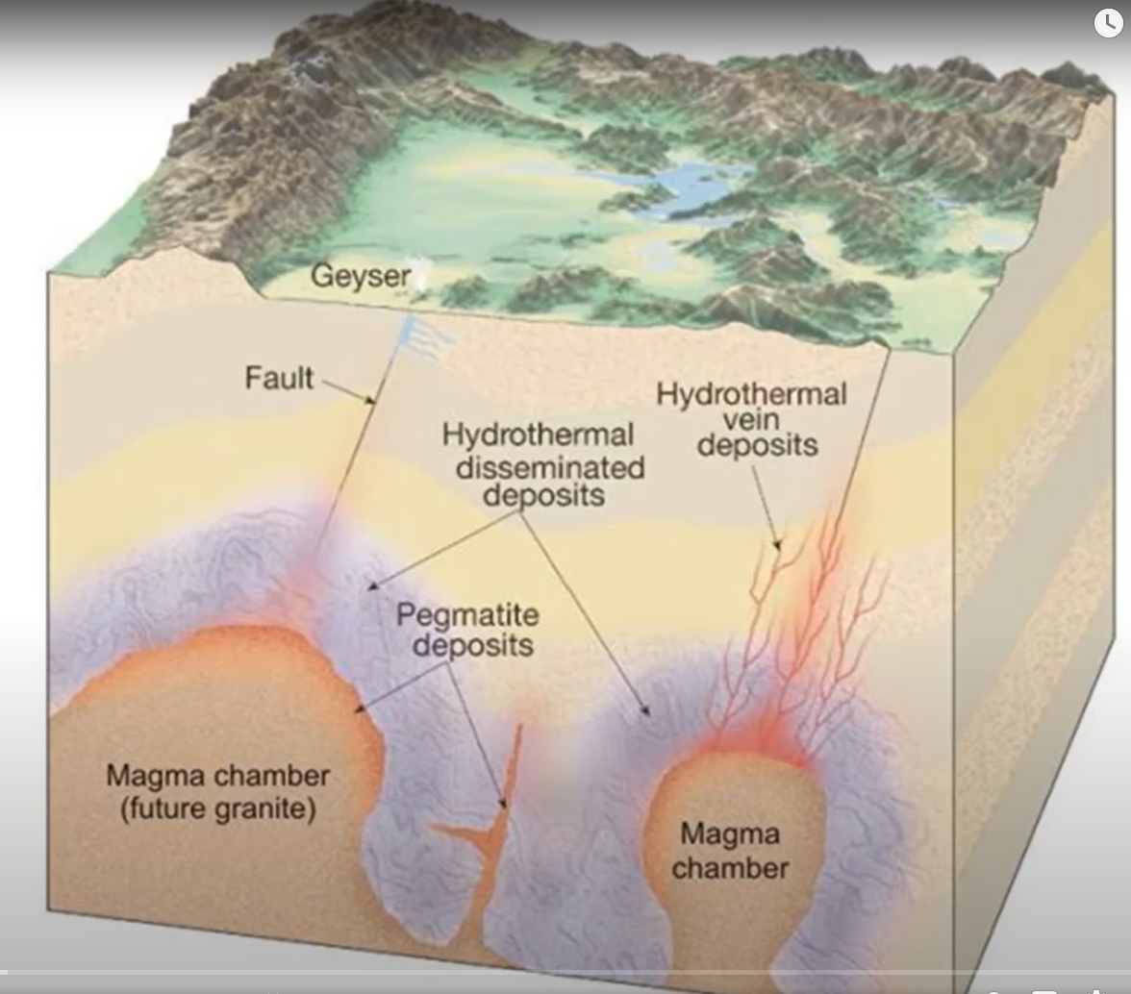
Hydrothermal ore forming processes
Magma and underground rock contain large amount of hot water with dissolved metals and minerals.
The mixture of hot water and dissolved ions is a hydrothermal solution.
If the metals precipitate in fractures in rock, a hydrothermal vein deposit forms.
Credit: Joanna Hodge https://www.youtube.com/watch?v=wInPtYnszR8
Notes:
Hydrothermal deposits are typically associated with magmatic activity and will often be located adjacent to magma chambers. They are often associated with geothermal features such as geysers, mud pools and fumaroles.

Slide 15
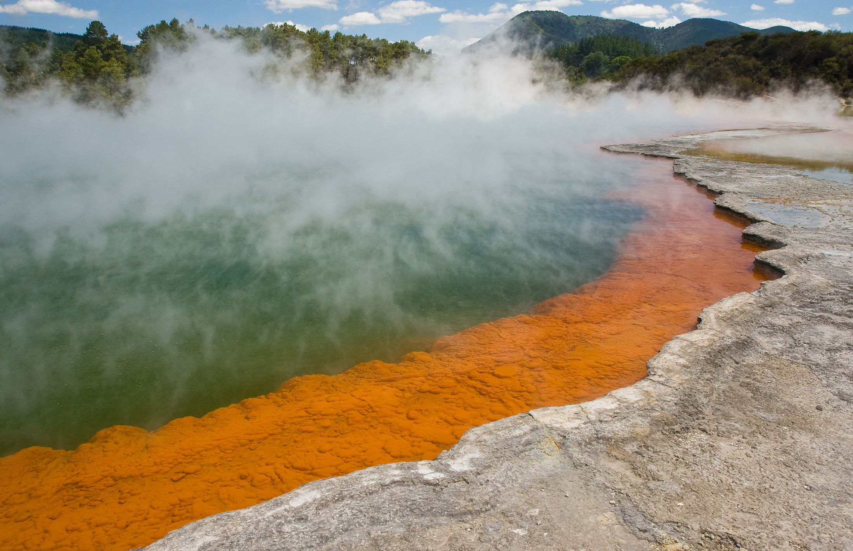
Champagne pool
Located at the Waiotapu geothermal field in New Zealand.
The orange crust around the edge is composed of orpiment and stibnite (i.e., arsenic and antimony sulfide)
Contains ~ 100 grams per tonne gold (super high grade)
By Christian Mehlführer, User:Chmehl - Own work, CC BY 2.5, https://commons.wikimedia.org/w/index.php?curid=3705012

Slide 16
Hydrothermal deposition
Mineral deposition takes place in the crust as a result of physical or chemical changes to the fluid.
Rapid temperature decrease:
Minerals are less soluble at lower temperatures and will precipitate out of solution, such as black smokers.
Notes:
Temperature decrease: very common at black smokers when hot hydrothermal fluids are expelled into cold ocean water, resulting in the formation of sulfide chimneys.

Slide 17
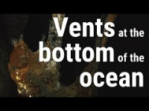
Hydrothermal vents
https://www.youtube.com/watch?v=rFHtVRKoaUM

Slide 18
Hydrothermal deposition
Mineral deposition takes place in the crust as a result of physical or chemical changes to the fluid.
Rapid temperature decrease:
Minerals are less soluble at lower temperatures and will precipitate out of solution, such as black smokers.
Rapid pressure decrease:
When rocks fracture or when fluids move into open cavities.
Resulting in over saturation of liquid phase and subsequent precipitation.
Chemical reaction:
Minerals precipitate when fluids react with wall rock such as limestone or iron bearing rocks that contain magnetite
Credit: Joanna Hodge https://www.youtube.com/watch?v=wInPtYnszR8
Notes:
Temperature decrease: very common at black smokers when hot hydrothermal fluids are expelled into cold ocean water, resulting in the formation of sulfide chimneys.

Slide 19
Chemical reaction: the example of Gold
Gold, commonly transported in a bisulfide solution (gold bearing hydrothermal fluid AuHS⁰, Au(HS)₂)
The gold bearing fluid interacts with magnetite.
The sulfur reacts with magnetite to form pyrite (FeS₂) and gold, which is no longer soluble, precipitates out of solution.
Gibert et al., 1998, https://hal-insu.archives-ouvertes.fr/insu-00797046/document

Slide 20
Examples of hydrothermal deposits
Volcanic-Hosted (or volcanogenic) massive sulfide (VHMS or VMS) deposits.
Cu-Pb-Zn-Au
Epithermal deposits
Au-Ag
Porphyry deposits
Cu, (Au, Mo)
Orogenic lode deposits
Au
Credit: Joanna Hodge https://www.youtube.com/watch?v=wInPtYnszR8
Notes:
Epithermal deposits: form some of the richest gold and silver deposits in the world
Epithermal: deposited from warm waters at rather shallow depth under conditions in the lower ranges of temperature and pressure —used of mineral veins and ore deposits (https://www.merriam-webster.com/dictionary/epithermal)
Hypothermal: of or relating to a hydrothermal metalliferous ore vein deposited at high temperature
Mesothermal: deposited from warm waters at intermediate depth under conditions in the medium ranges of temperature and pressure —used of mineral veins and ore deposits

Slide 21
Porphyry copper deposits
Porphyry copper deposits are copper ore bodies that are formed from hydrothermal fluids that originate from a voluminous magma chamber several kilometers below the deposit itself. Predating or associated with those fluids are vertical dikes of porphyritic intrusive rocks from which this deposit type derives its name.
https://en.wikipedia.org/wiki/Porphyry_copper_deposit

Slide 22
Intrusive igneous rocks
Intrusive rock is formed when magma penetrates existing rock, crystallizes, and solidifies underground to form intrusions, such as batholiths, dikes, sills, laccoliths, and volcanic necks.
Intrusion is one of the two ways igneous rock can form. The other is extrusion, such as a volcanic eruption or similar event. An intrusion is any body of intrusive igneous rock, formed from magma that cools and solidifies within the crust of the planet. In contrast, an extrusion consists of extrusive rock, formed above the surface of the crust.

Slide 23
Porphyritic
Porphyritic is an adjective used in geology to describe igneous rocks with a distinct difference in the size of mineral crystals, with the larger crystals known as phenocrysts.
Both extrusive and intrusive rocks can be porphyritic, meaning all types of igneous rocks can display some degree of porphyritic texture.
Most Porphyritic rocks have bimodal size ranges, meaning the rock is composed of two distinct sizes of crysta.
https://en.wikipedia.org/wiki/Porphyritic

Slide 24
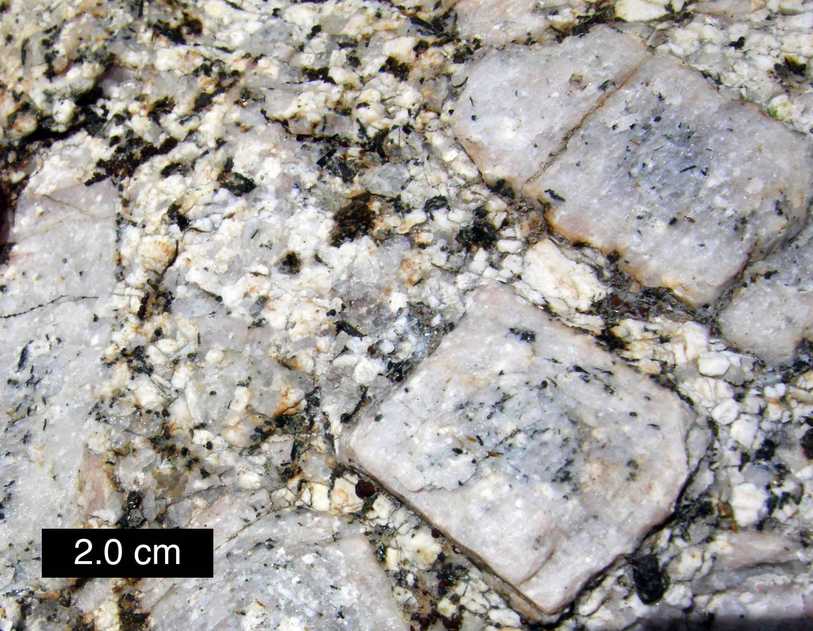
Porphyritic texture in a granite. This is an intrusive porphyritic rock. The white, square feldspar phenocrysts are much larger than crystals in the surrounding matrix; eastern Sierra Nevada, Rock Creek Canyon, California.

Slide 25
Geology of porphyry copper deposits
https://www.911metallurgist.com/blog/geology-of-porphyry-copper-deposits

Slide 26
Outline
Copper
Magma fertility
Data

Slide 27
Geochemical data contain information about whether magma are fertile (meaning that when magma cools down, copper will form) or not
Trace-element geochemical measurements of zircon (a ubiquitous and geochemically robust accessory mineral in intermediate to felsic igneous rocks) are also used as indicators of magma fertility.

Slide 28
Zircon
zirconium silicate (ZrSiO₄)
Zircon crystallizes from the melt that saturates in zirconium. Zircon is formed in felsic samples, but is sometimes found in mafic cumulates.
Zircon is one of the oldest earth minerals and is a common mineral in meteorite and moon rocks

Slide 29
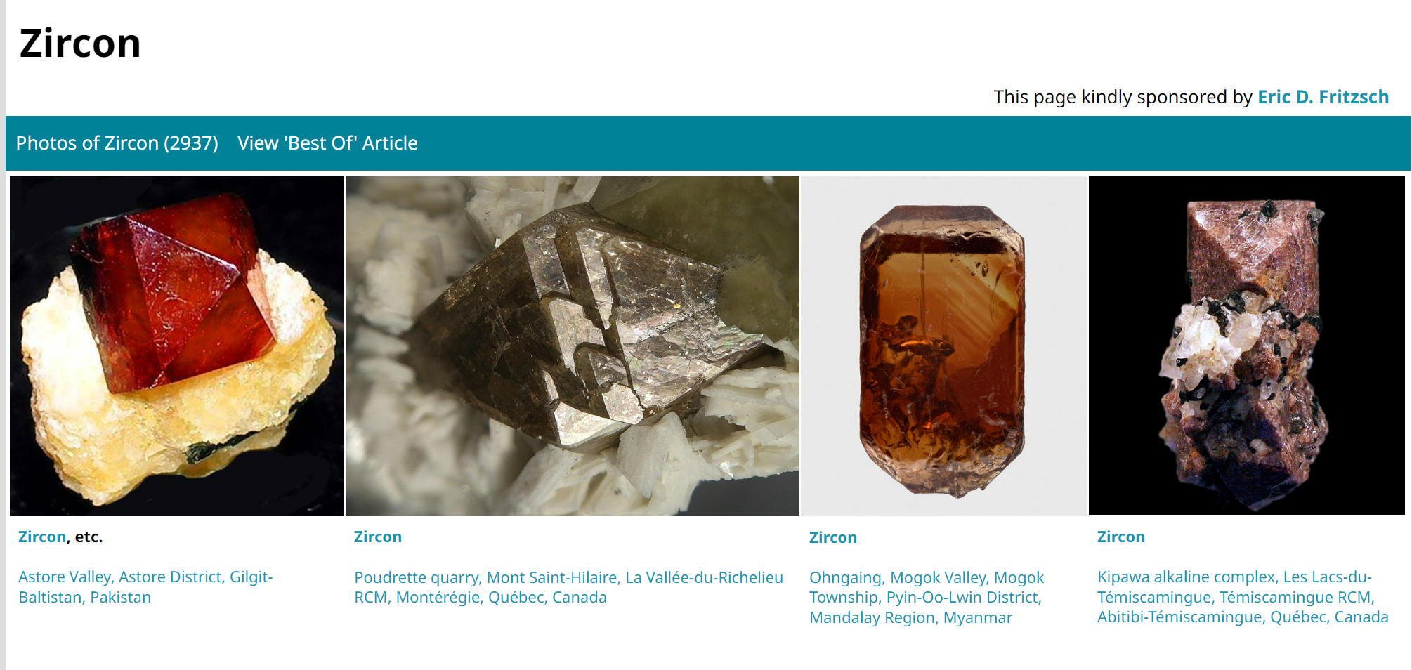

Slide 30
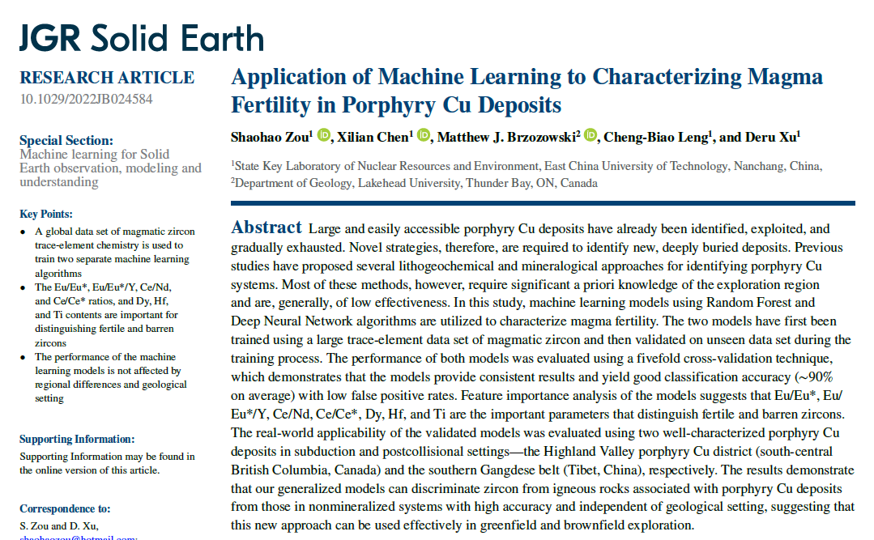
Zou et al. (2022)

Slide 31
Data
The authors used a large zircon trace-element geochemica data set from the GEOROC database.
Zircon trace-element data collected from representative mineralized intrusions from 27 economic porphyry deposits around the world were labeled as “fertile zircon,” whereas data from intrusions without any mineralization were labeled as “barren zircon.”
The sources of the data are summarized in Table 1.

Slide 32
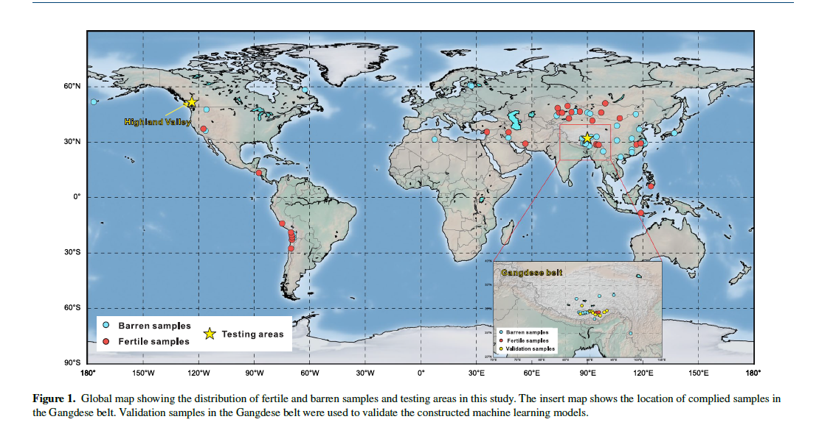

Slide 33
Methods
They applied Random Forest and Neural Network.
They used a fivefold cross-validation to evaluate their machine learning models.

Slide 34
Field data
After training, they applied their ML models to two sets of field data, one from Canada and the other from China.

Slide 35
What to do next?
Read the paper
Read the paper
Obtain the data
Get to know your data
Data preprocessing
Data visualization

